Slide 1
Research
Data Management
Processing Scientific Data

Slide 2
BSc Research Skills Week
Research Data Management (FAIR)
Security
Potential implementation, tips & tricks, for 'my data' to be compatible with FAIR
Our hardware infrastructure

Slide 3
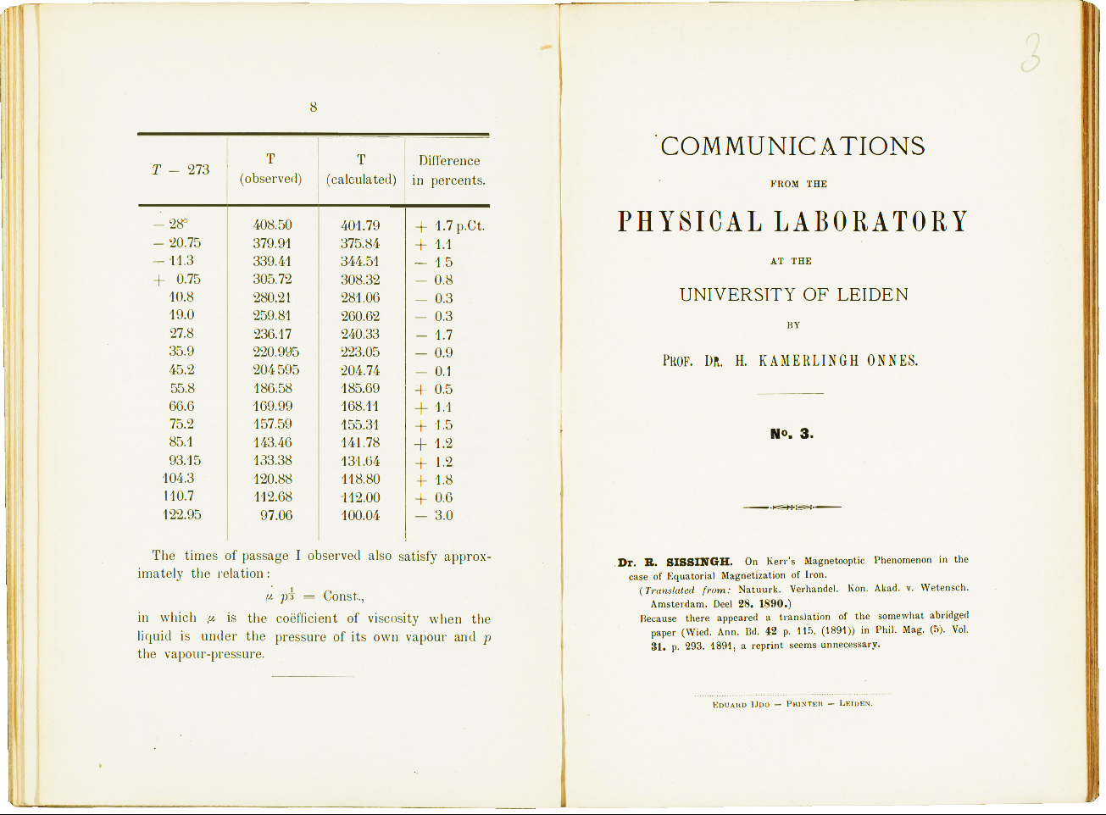

Slide 4
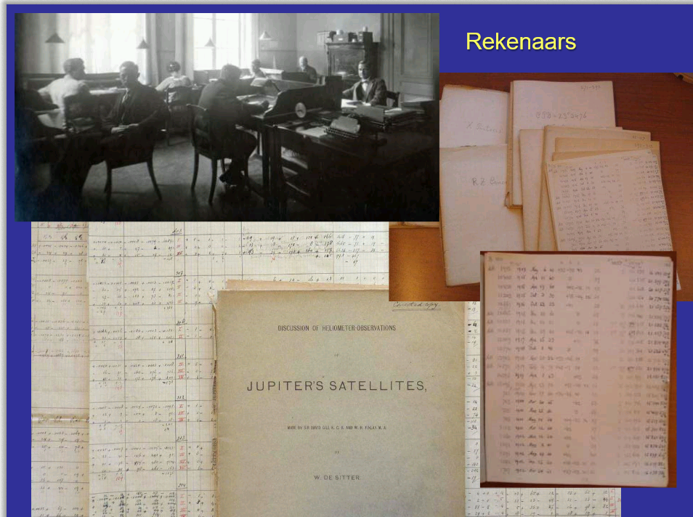

Slide 5
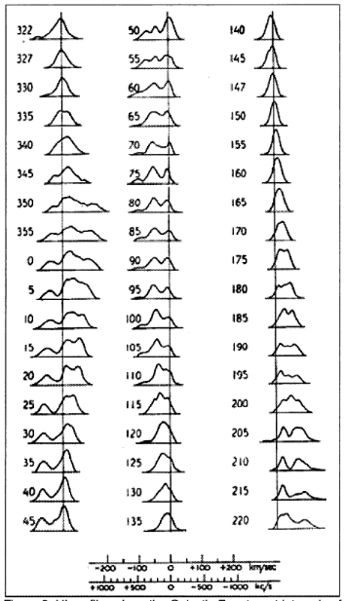
From Dwingeloo Radio Telescope to LOFAR to …
In June 1952 the first major survey was started, consisting of profiles taken at fifty-four positions at 5º intervals in Galactic longitude along the Galactic Equator. Data rate order 0.1B/s.
In order to fully exploit this new wavelength regime with unprecedented resolution and sensitivity, LOFAR must meet several non-trivial technical challenges. Furthermore, for the typical sampling rate of 200 MHz, the raw data-rate generated by the entire LOFAR array is 13 Tbit/s.

Slide 6
What is Data Management
Handling information

Slide 7
Research Data Management (RDM)
What is RDM
Why RDM
How RDM
Data management plan & Code of conduct

Slide 8
Ask a Question
Reflect
on the process & results
Set a Purpose
The
Scientific Process
Draw a Conclusion
Plan & Research
Analyze
the Data
Make a
Hypothesis
Experiment & Gather Data

Slide 9
What is Research Data Management
Research data management concerns the organization of data, from its entry to the research cycle through to the dissemination and archiving of valuable results.
Research Data Management is part of the research process, and aims to make the research process as efficient as possible, and meet expectations and requirements of the university, research funders, and legislation.
It concerns how you:
Create data and plan for its use,
Organize, structure, and name data,
Keep it – make it secure, provide access, store and back it up,
Find information resources, and share with collaborators and more broadly, publish and get cited.

Slide 10
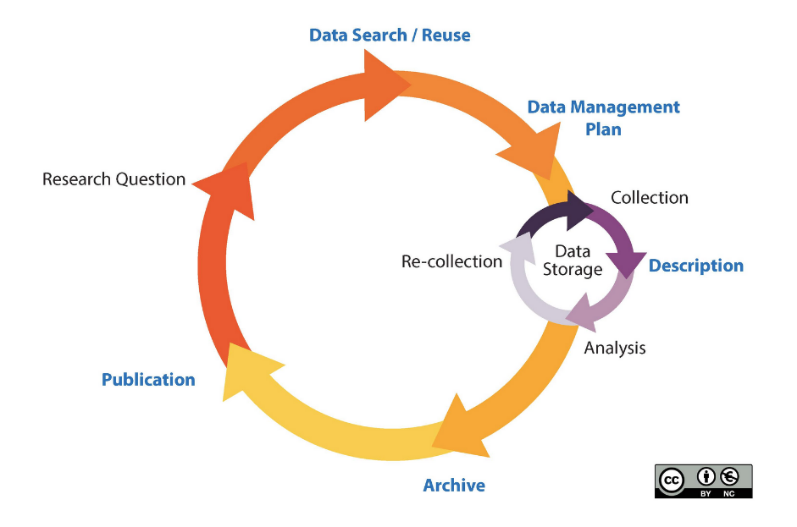
Research Data Management Lifecycle

Slide 11
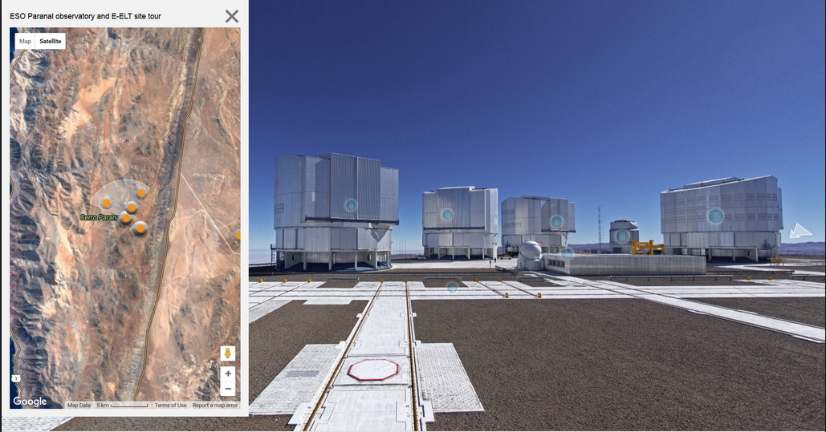
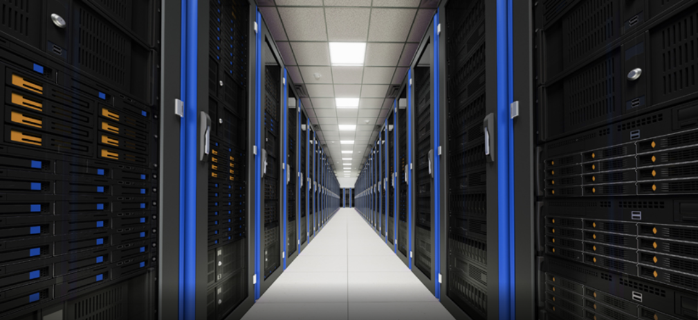
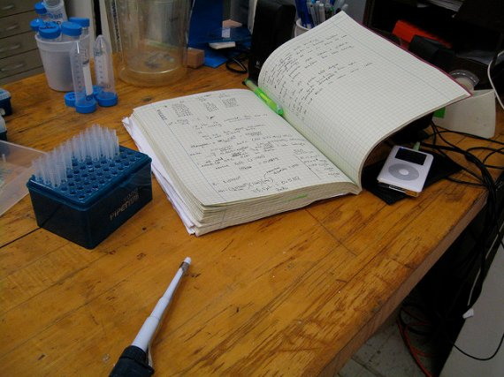
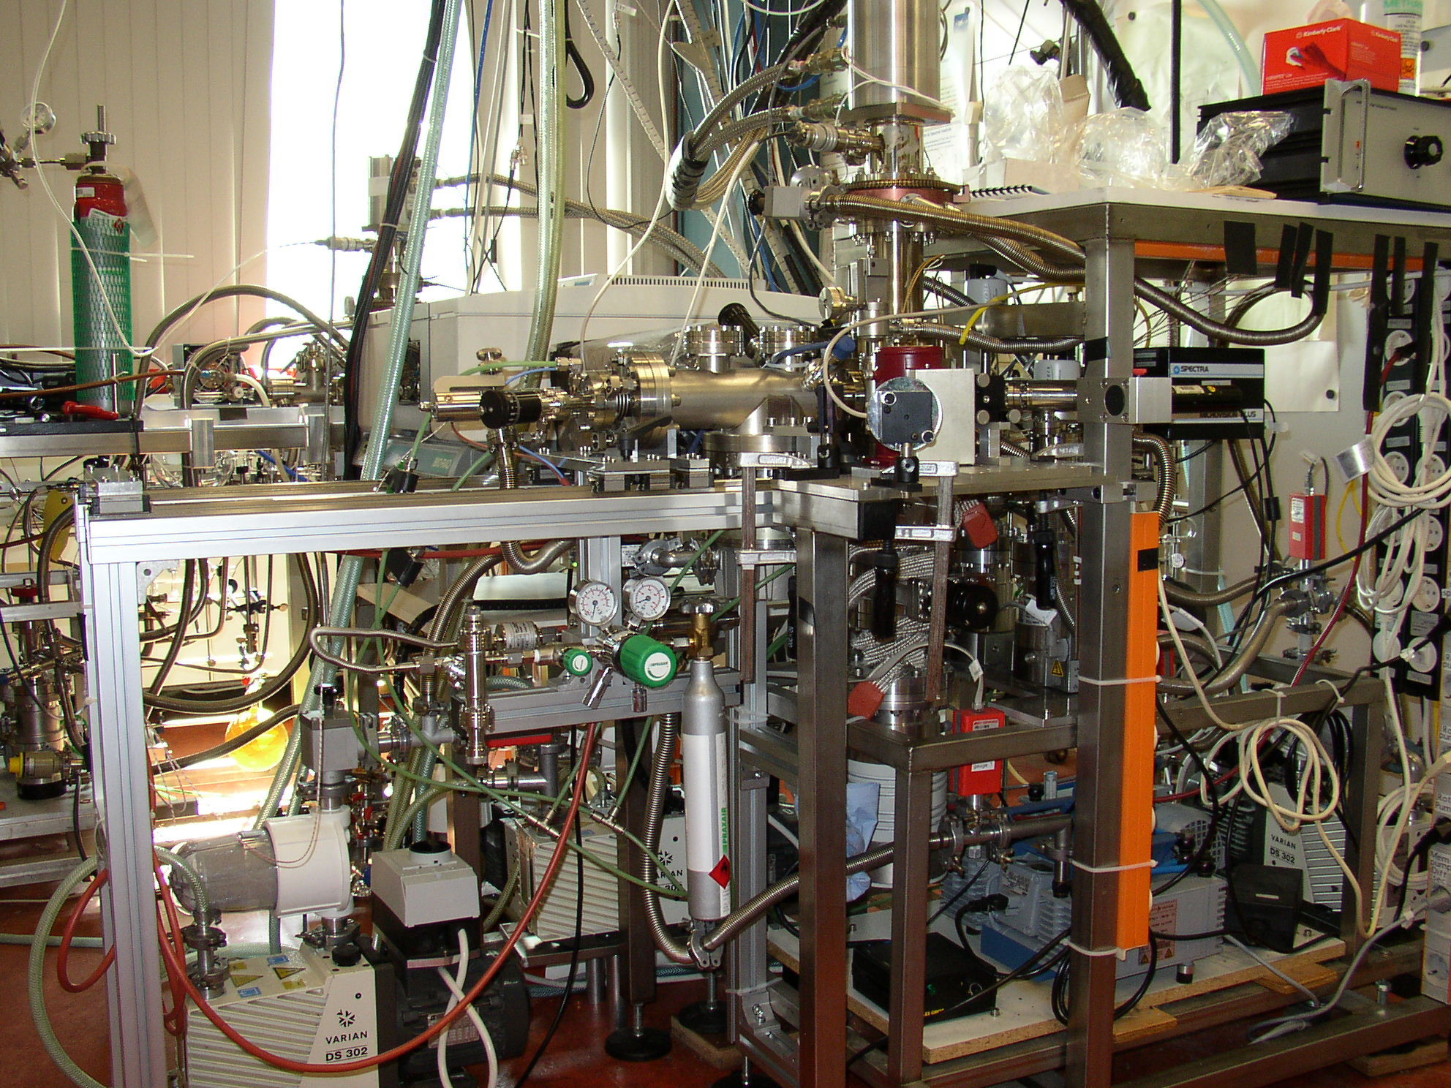
What is Research Data Management
Create and plan for its use

Slide 12
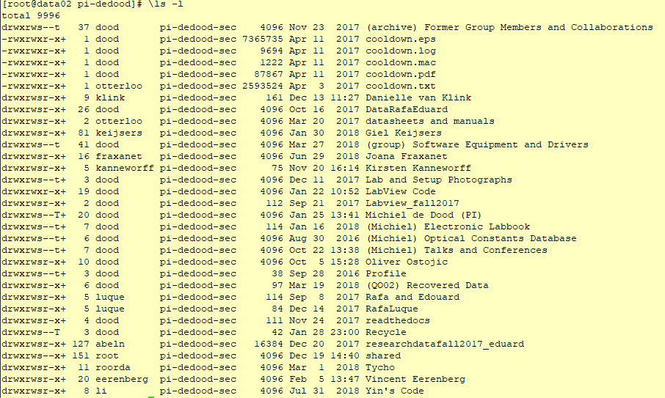
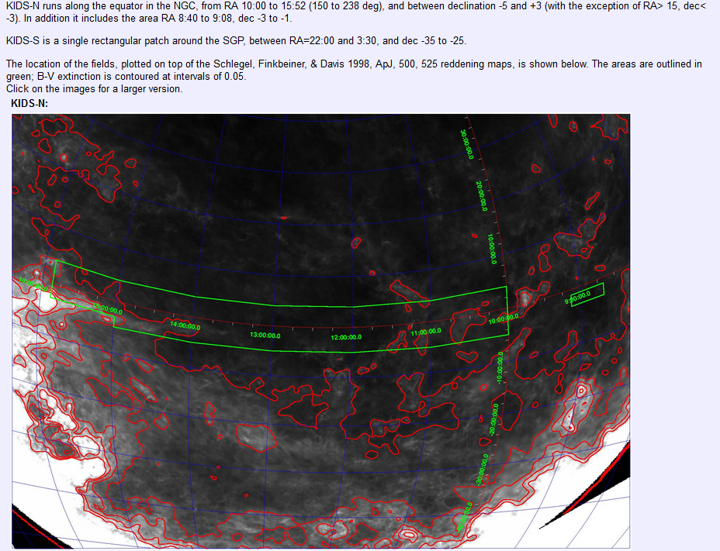
What is Research Data Management
Organize, structure, and name data

Slide 13
What is Research Data Management
Keep it – make it secure, provide access, store and back it up
DNA sequencing or personal home page
  http://home.physics.leidenuniv.nl/~noort/cgi-bin/nup3_st.py
  http://wwwhome.lorentz.leidenuniv.nl/~kschalm/
EAGLE simulations
  http://eagle.strw.leidenuniv.nl/

Slide 14
What is Research Data Management
Make it findable, allow for Archival research.
Virtual Observatory
Aladin Lite
MAST
CERN
Opendata

Slide 15
What is Research Data Management
Find information resources, and share with collaborators and more broadly, publish and get cited.
Astronomy
  https://ui.adsabs.harvard.edu/
Physics (All)
  https://apps.webofknowledge.com/WOS_GeneralSearch_input.do?product=WOS&search_mode=GeneralSearch

Slide 16
Why Data Management
History of questionable practices

Slide 17
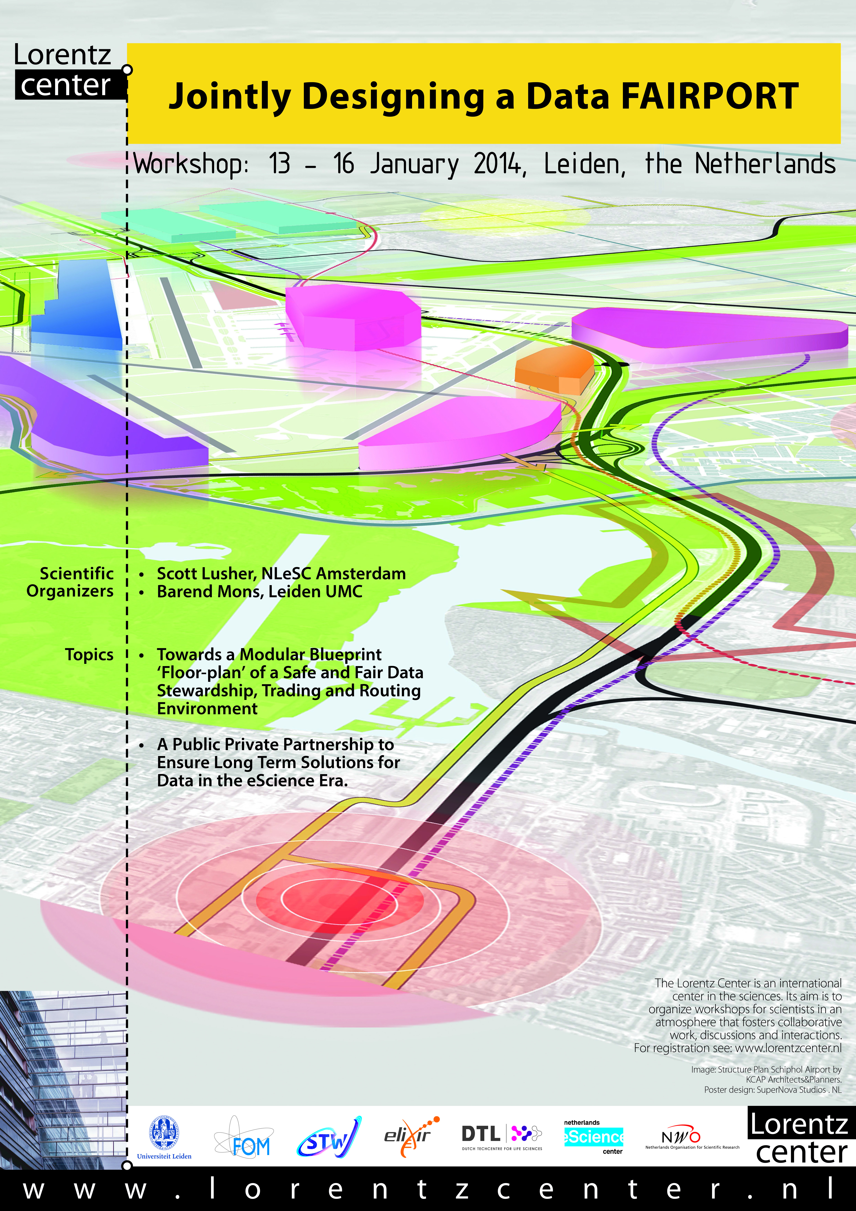
Why Research Data Management
Since the public disclosure of Diederik Stapel’s fraud
Falsification and fabrication, and not about plagiarism
Resulted in the development or (re)enforcement of a number of measures and regulations to foster a climate of scientific integrity nationally and at institutional levels
In January 2014, representatives of a range of stakeholders came together at the request of the Netherlands eScience Center and the Dutch Techcentre for the Life Sciences (DTL) at the Lorentz Center in Leiden.
  Jointly Designing a Data FAIRport

Slide 18
Why Research Data Management
Concerns the organization of data,
from the start when data are collected
through to the dissemination and
archiving of valuable results.
It aims to ensure
reliable verification of results, and
permits new and innovative research built on existing information.

Slide 19
Why Research Data Management
By managing your data you will:
Guarantee research integrity and replication.
Ensure that research data are authentic, complete, and reliable.
Minimize the risk of losing your data.
Increase research efficiency.
Prevent duplication of effort by enabling others to use your data.
Meet funding agency requirement.

Slide 20
Why Research Data Management
More practical reasons to do RDM
Good science is based on 'good' data
You do not wish to run the risk of data loss (computer crash, researchers' mobility, ...)
You yourself might wish to reuse the data at a later stage - and you'd like to be able to trace in how the data were obtained and analyzed
Some research can only be done once (archeological excavation, meteorological observations, ...) and must be well documented
You care about scientific integrity

Slide 21
Why Research Data Management
You want to guarantee research reproducibility as much as possible
You are concerned about intellectual property rights on data which you created or processed
You wish to share your data since you also reuse existing data
You are involved in a multi-partner project and agreements on dealing with the data need to be in place
Publishing research data is a scientifically acknowledged output which can generate citations
Your funder wants you to (NWO, Horizon 2020)

Slide 22
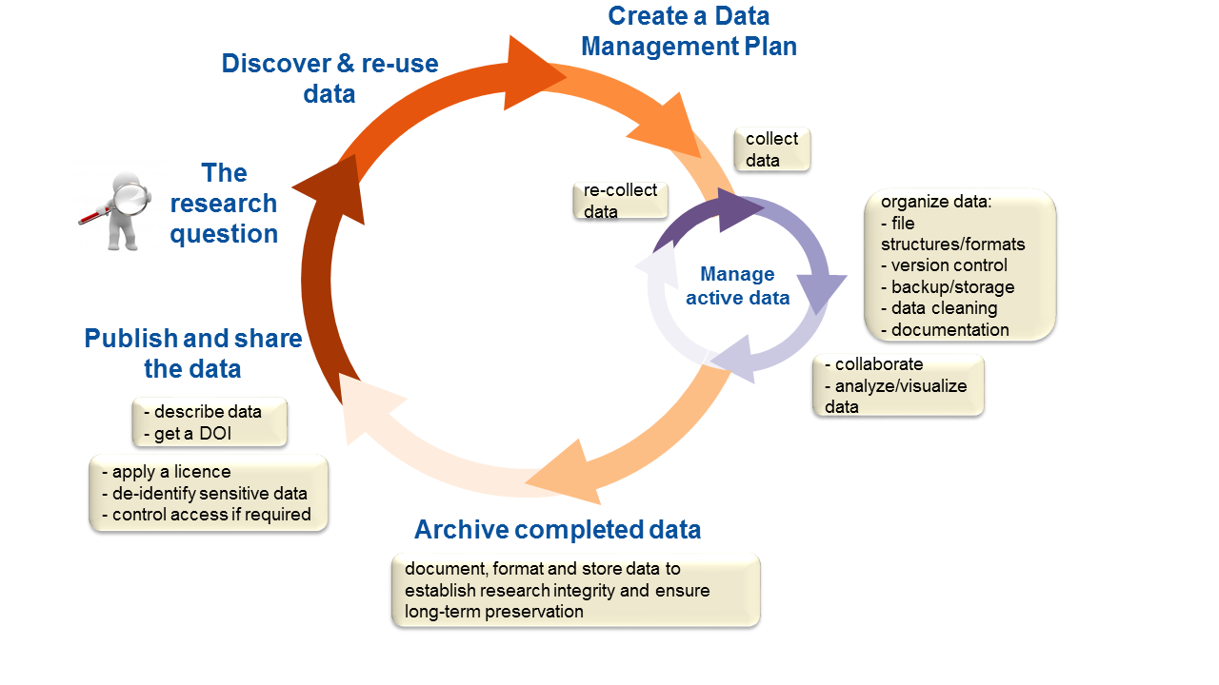

Slide 23
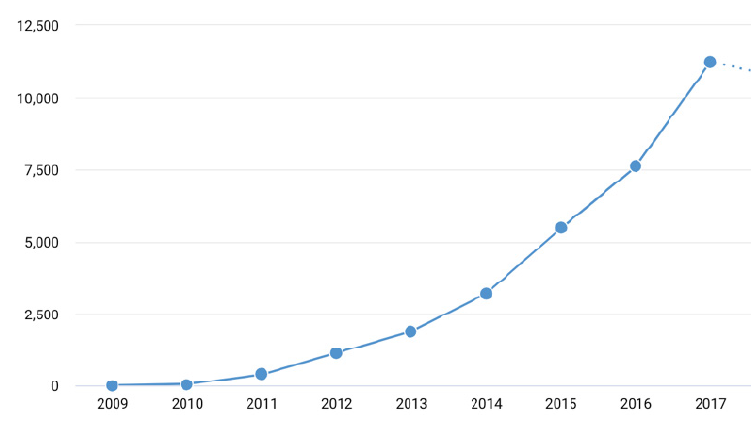
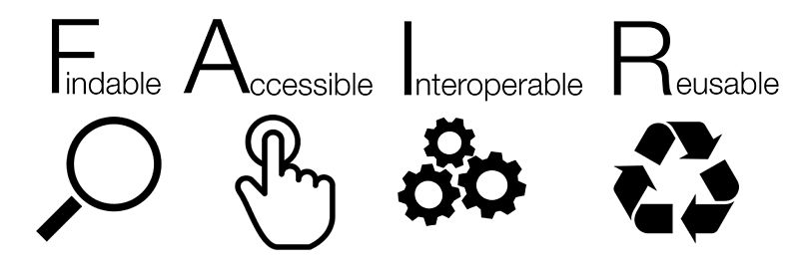

Research Data: “A Gift of Abundance”
Data citations
Year
The hockey stick graph indicates the exponential growth of datasets that are being made available.
Source: The State of Open Data 2018, Digital Science Report

Slide 24
Why Research Data Management
FAIR Facets (The FAIR Guiding Principles for scientific data management and stewardship):
Data should be Findable
Data should be Accessible
Data should be Interoperable
Data should be Re-usable.

Slide 25
Findable
F1. (meta)data are assigned a globally unique and persistent identifier
F2. data are described with rich metadata
F3. metadata clearly and explicitly include the identifier of the data it describes
F4. (meta)data are registered or indexed in a searchable resource

Slide 26
Metadata
Data that provides information about other data
Descriptive metadata describes a resource for purposes such as discovery and identification. It can include elements such as
  Title
  Abstract
  Author(s)
  Keywords
  Digital format
  Terms and conditions
  Location
  PID

Slide 27
Metadata
Only difference between data and metadata is mode of use
Metadata is not just data, it is also for users, software services, computing resources
Not just for description and discovery, also for contextualization (relevance, quality, restrictions) and for coupling users, software and computing resources to data
Must be machine understandable as well as human understandable

Slide 28
Accessible
A1. (meta)data are retrievable by their identifier using a standardized communications protocol
A1.1 the protocol is open, free, and universally implementable
A1.2 the protocol allows for an authentication and authorization procedure, where necessary
A2. metadata are accessible, even when the data are no longer available

Slide 29
Accessible
Community Standards
Gladiator
Gladiator at IMDB
Schema.org
Mons et al., 2017
Journal article tag suite (JATS)
http://www.cellimagelibrary.org/images/40654

Slide 30
Interoperable
I1. (meta)data use a formal, accessible, shared, and broadly applicable language for knowledge representation.
I2. (meta)data use vocabularies that follow FAIR principles
I3. (meta)data include qualified references to other (meta)data

Slide 31
Reusable
R1. meta(data) are richly described with a plurality of accurate and relevant attributes
R1.1. (meta)data are released with a clear and accessible data usage license
R1.2. (meta)data are associated with detailed provenance
R1.3. (meta)data meet domain-relevant community standards

Slide 32
How Data Management
With examples in Astronomy

Slide 33
Findable
To ensure Findability,
Select a data repository at an early stage and check out its data format and metadata requirements;
Make sure the data can get a persistent identifier so that it can be cited;
May be select a catalogue to make your data more findable, especially if the repository is more generic in nature.

Slide 34
Findable
Astronomy
  Registries: the Virtual Observatory Yellow Pages
  http://registry.euro-vo.org/evor
  http://simbad.u-strasbg.fr/simbad/

Slide 35
Metadata examples
HISTORY === Data ===
HISTORY Data-MS = mslist.txt
HISTORY Data-ColName = DATA_DI_CORRECTED
HISTORY Data-ChunkHours = 0.0
HISTORY Data-Sort = True
HISTORY === Predict ===
HISTORY Predict-ColName = DD_PREDICT
HISTORY Predict-MaskSquare = None
HISTORY Predict-FromImage = None
HISTORY Predict-InitDicoModel = image_ampphase1m_masked.DicoModel
HISTORY Predict-Overwrite = True
HISTORY === Selection ===
HISTORY Selection-Field = 0
HISTORY Selection-DDID = 0
HISTORY Selection-TaQL =
HISTORY Selection-ChanStart = 0
HISTORY Selection-ChanEnd = -1
HISTORY Selection-ChanStep = 1
HISTORY Selection-FlagAnts =
HISTORY Selection-UVRangeKm = [0.1, 1000.0]
HISTORY Selection-TimeRange =
HISTORY Selection-DistMaxToCore =
HISTORY === Output ===
HISTORY Output-Mode = Clean
HISTORY Output-Clobber = False
HISTORY Output-Name = image_ampphase1_di
HISTORY Output-ShiftFacetsFile = None
HISTORY Output-RestoringBeam = 24.0
HISTORY Output-Also = onNeds
HISTORY Output-Cubes =
HISTORY Output-Images = DdPAMRIikz
HISTORY Output-alphathreshold = 7
HISTORY Output-alphamaskthreshold = 15
HISTORY Output-StokesResidues = I
CUNIT1 = 'deg' / Units of coordinate increment and value
CUNIT2 = 'deg' / Units of coordinate increment and value
CUNIT4 = 'Hz' / Units of coordinate increment and value
CTYPE1 = 'RA---SIN' / Right ascension, orthographic/synthesis project
CTYPE2 = 'DEC--SIN' / Declination, orthographic/synthesis projection
CTYPE3 = 'STOKES' / Coordinate type code
CTYPE4 = 'FREQ' / Frequency (linear)
CRVAL1 = 123.4 / [deg] Coordinate value at reference point
CRVAL2 = 48.2175083333 / [deg] Coordinate value at reference point
CRVAL3 = 1.0 / Coordinate value at reference point
CRVAL4 = 54002380.371094 / [Hz] Coordinate value at reference point
LONPOLE = 180.0 / [deg] Native longitude of celestial pole
LATPOLE = 48.2175083333 / [deg] Native latitude of celestial pole
RADESYS = 'ICRS' / Equatorial coordinate system
RESTFRQ = 54002380.37109375
ORIGIN = 'DDFacet 0.3.4.1-1a98298'
BTYPE = 'Intensity'
BUNIT = 'Jy/beam '
SPECSYS = 'TOPOCENT'
OBJECT = 'c05-o04_3c196'
DATE-OBS= '2016-02-05'
TELESCOP= 'LOFAR '
OBSERVER= 'unknown '
DATE-MAP= '2018-06-22'
Astronomy
FITS header
SIMPLE = T / conforms to FITS standard
BITPIX = -32 / array data type
NAXIS = 4 / number of array dimensions
NAXIS1 = 10125
NAXIS2 = 10125
NAXIS3 = 1
NAXIS4 = 1
WCSAXES = 4 / Number of coordinate axes
CRPIX1 = 5063.0 / Pixel coordinate of reference point
CRPIX2 = 5063.0 / Pixel coordinate of reference point
CRPIX3 = 1.0 / Pixel coordinate of reference point
CRPIX4 = 1.0 / Pixel coordinate of reference point
CDELT1 = -0.00083333333333333 / [deg] Coordinate increment at reference point
CDELT2 = 0.00083333333333333 / [deg] Coordinate increment at reference point
CDELT3 = 1.0 / Coordinate increment at reference point
CDELT4 = 1.0 / [Hz] Coordinate increment at reference point

Slide 36
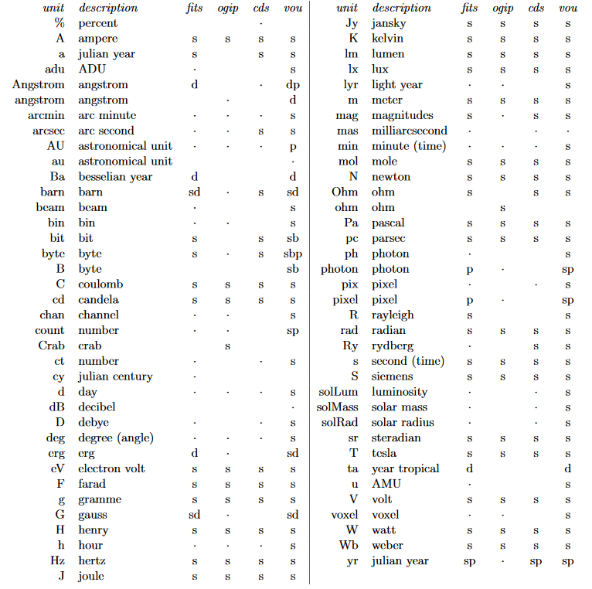

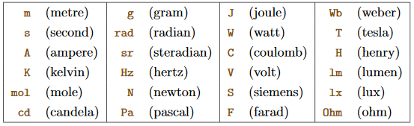
Metadata examples
IVOA
UCD: Unified Content Descriptor
P| pos.wcs | WCS keywords
P| pos.wcs.cdmatrix | WCS CDMATRIX
P| pos.wcs.crpix | WCS CRPIX
P| pos.wcs.crval | WCS CRVAL
P| pos.wcs.ctype | WCS CTYPE
P| pos.wcs.naxes | WCS NAXES
P| pos.wcs.naxis | WCS NAXIS
P| pos.wcs.scale | WCS scale or scale of an image
Q| spect | Spectroscopy
Q| spect.binSize | Spectral bin size
S| spect.continuum | Continuum spectrum
Q| spect.dopplerParam | Doppler parameter b
E| spect.dopplerVeloc | Radial velocity, derived from the shift of some spectral feature
E| spect.dopplerVeloc.opt | Radial velocity derived from a wavelength shift using the optical convention
E| spect.dopplerVeloc.radio | Radial velocity derived from a frequency shift using the radio convention
E| spect.index | Spectral index
S| spect.line | Spectral line
E| spect.line.asymmetry | Line asymmetry
E| spect.line.broad | Spectral line broadening
Q| spect.line.broad.Stark | Stark line broadening coefficient
E| spect.line.broad.Zeeman | Zeeman broadening
E| spect.line.eqWidth | Line equivalent width
E| spect.line.intensity | Line intensity
E| spect.line.profile | Line profile
Q| spect.line.strength | Spectral line strength S
E| spect.line.width | Spectral line full width half maximum
Q| spect.resolution | Spectral (or velocity) resolution
S| em.radio.6-12GHz | Radio between 6 and 12 GHz
S| em.radio.12-30GHz | Radio between 12 and 30 GHz
Q| em.wavenumber | Wavenumber value in the em frame
Q| em.wl | Wavelength value in the em frame
Q| em.wl.central | Central wavelength
Q| em.wl.effective | Effective wavelength
Q| instr | Instrument
E| instr.background | Instrumental background
Q| instr.bandpass | Bandpass (e.g.: band name) of instrument
Q| instr.bandwidth | Bandwidth of the instrument
Q| instr.baseline | Baseline for interferometry
S| instr.beam | Beam
Q| instr.calib | Calibration parameter
S| instr.det | Detector
Q| instr.det.noise | Instrument noise
Q| instr.det.psf | Point Spread Function
Q| instr.det.qe | Quantum efficiency
Q| instr.dispersion | Dispersion of a spectrograph
Q| instr.experiment | Experiment or group of instruments

Slide 37
Accessible
To ensure Accessibility,
Guarantee longevity of the data (e.g., by submitting it to a repository that has a certification like the Data Seal of Approval or an ISO certification);
Check and describe the legal conditions under which the data can be made available (this is generally easier to do before you have collected and interpreted the data);
Establish an embargo period if necessary;
Make sure your ICT infrastructure will keep the data available even in case of equipment failure or human error.

Slide 38
Accessible
IVOA
  Standard data formats and models
    UCD’s and VOUnits
    VOEvents
    VOTable
    …
  Passing data between applications
    APP (simple application messaging protocol)
    DAL (Data access layer)
    …

Slide 39
Accessible
IVOA
  Data Services
    Cone search
    Table Access Protocol (TAP)
    Simple Image Access Protocol (SIAP)
    Simple Spectral Access Protocol (SSAP)
    …

Slide 40
Interoperable
To ensure Interoperability,
Select commonly used data formats;
Select commonly used vocabularies for data items.

Slide 41
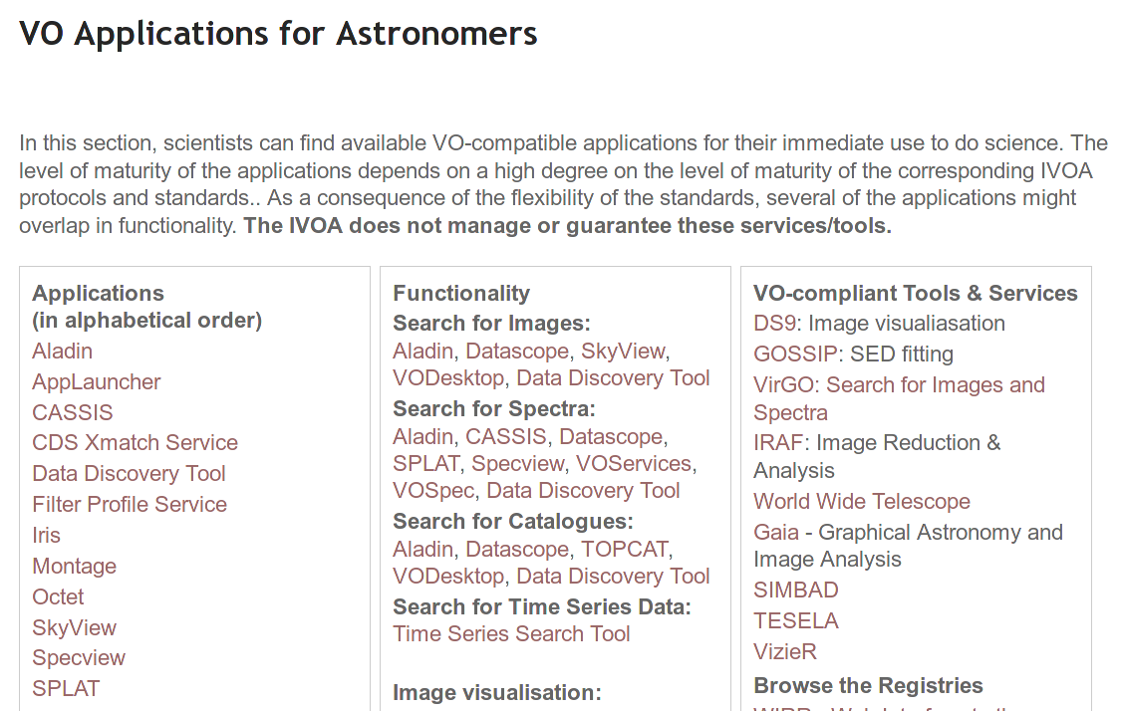
Interoperable
IVOA VO Software

Slide 42
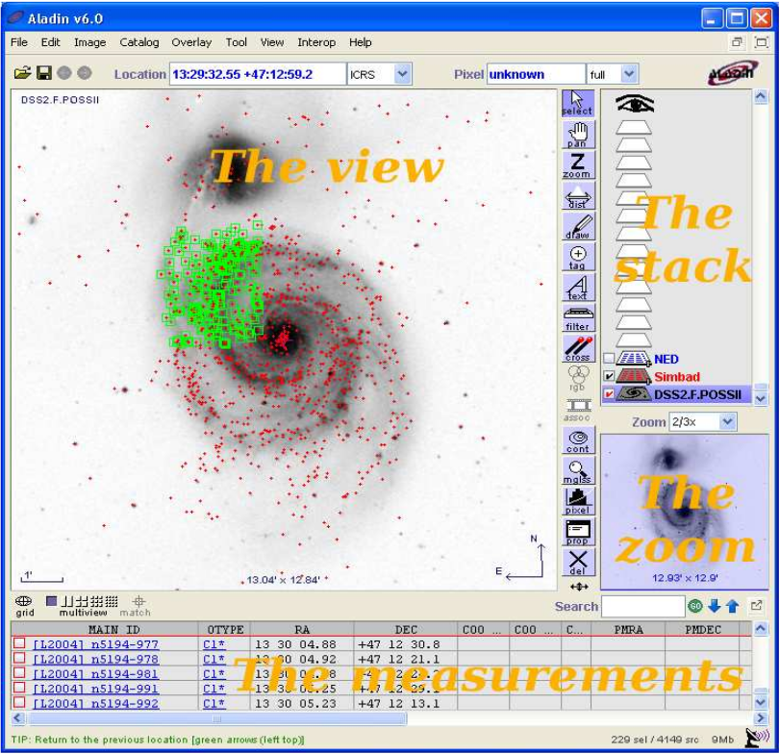
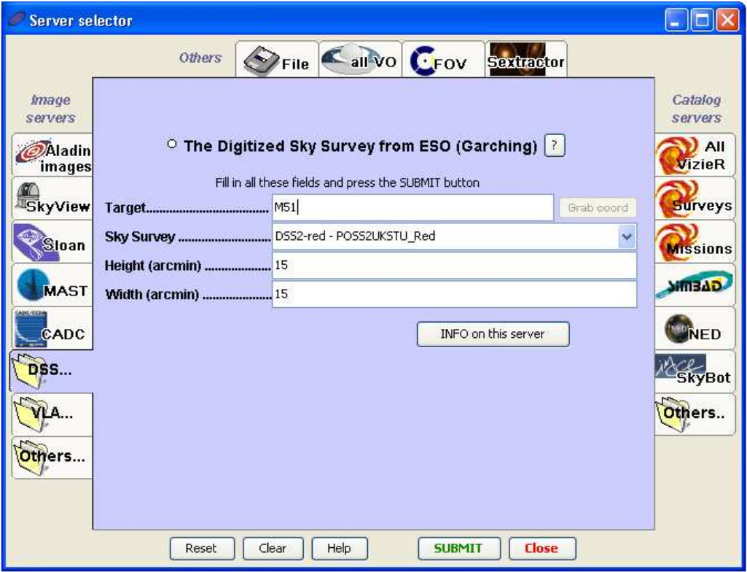
Interoperable
IVOA VO Software

Slide 43
Reusable
To ensure Reusability,
Make sure you keep proper provenance information (i.e., details about how and where the data was generated, including machine settings, and details about all processing steps, such as the software tools with their versions and parameters);
Select the right minimal metadata standard and collect the necessary metadata (many minimal metadata standards are included in ELIXIR’s biosharing.org repository);
Select a license for the data (preferably an open license) and the associated software tools;
Make sure the important conclusions of your study will not only be available in a paper in narrated form, but also in a digital file (e.g., a nanopublication).
Licenses datasets:
Creative Commons License (open content)
Open source Licenses:
Mit, Apache, GPL
Data repository Licenses:
DANS, 4TU.Center

Slide 44
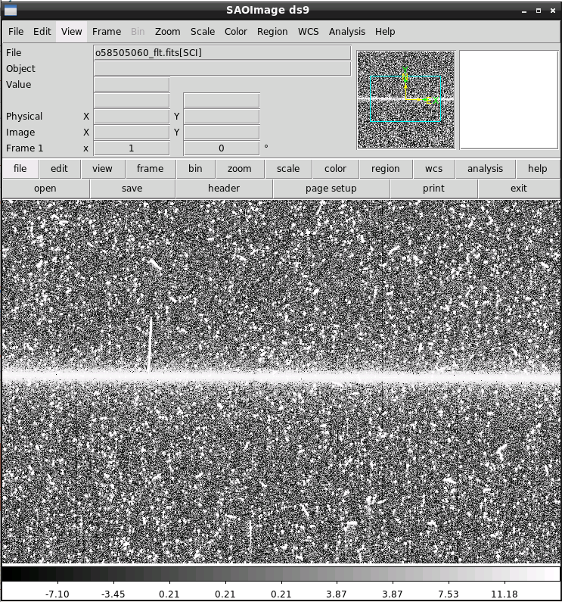
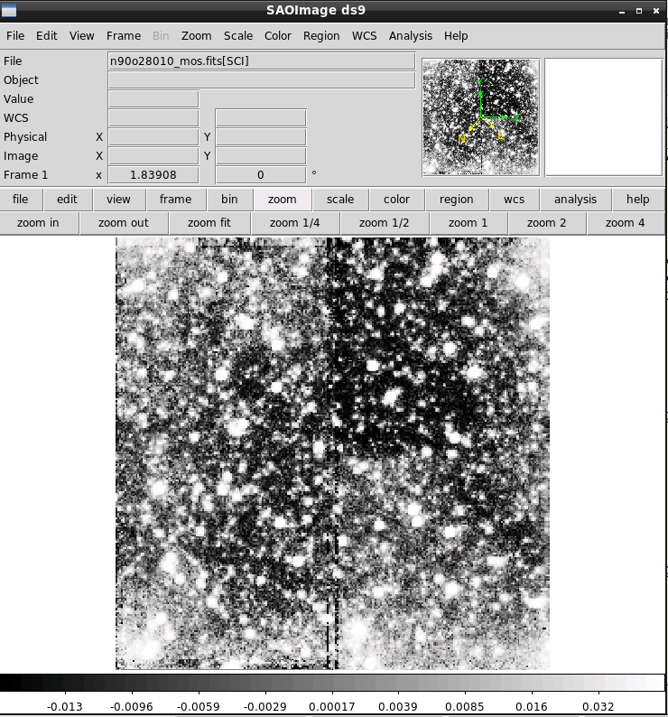
Reusable
MAST: https://archive.stsci.edu/
  Search
  Download
  FITS
  TOPCAT

Slide 45
Data Management Plan & Code of Conduct
How it should be done

Slide 46
Good Practice
Research data can be preserved for different reasons, for example for analysis or further research, or because a funder demands it. If you decide to preserve data for the long term, these guideline will help you selecting the data.
There can be different reasons for preserving research data:
They are valuable: potential value in terms of re-use, national/international standing and quality, originality, size, scale, costs of data production or innovative nature of the research
They are unique: the data contain non-repeatable observations
They are important for history, in particular the history of science
They are important for non-academic purposes, such as for cultural heritage, museums or other presentations

Slide 47
Good Practice
To preserve research data based on the reasons given before, there are several things to keep in mind:
Technical: which data formats, software (standard or tailor-made: research-specific tools), hardware?
Metadata: available and sufficient? Technical information, codebooks, information on data structure, contextual information, information on intellectual property rights, links with publications or related data.
Data: which data from which point of the digital life cycle: raw data, intermediate data, published data?
Clarity on intellectual property rights, for example copyright, patent and/or database rights, privacy protection?
Infrastructure available for preserving the data? Either a data archive or an institutional or thematic repository.
Costs: how are the costs to be covered for selecting, converting, preserving and making the data available?

Slide 48
The Code of Conduct for Research Integrity
Principles can be regarded as ‘virtues’ of a good researcher, guiding them towards the right choices in all kinds of circumstances. These are:
Honesty
  reporting the research process accurately
Scrupulousness
  using methods that are scientific or scholarly and exercising the best possible care in designing, undertaking, reporting and disseminating research

Slide 49
The Code of Conduct for Research Integrity
Transparency
  ensuring that it is clear to others what data the research was based on, how the data were obtained, what and how results were achieved and what role was played by external stakeholders
Independence
  the assessment of data, the weight attributed to alternative statements or the assessment of others’ research or research proposals to be guided by non-scientific or non-scholarly considerations
Responsibility
  conducting research that is scientifically and/or societally relevant

Slide 50
The Code of Conduct for Research Integrity
Institutions provide a working environment that promotes and safeguards good research practices.
Non-compliance with standards undermines professional responsibility, which harms the research process and the relationship between individual researchers, and possibly also trust in and the credibility of the research.

Slide 51
Data Management Plan – general definition
Data Management Plans (DMPs) are a key element of good data management. A DMP describes the data management life cycle for the data to be collected, processed and/or generated by a Horizon 2020 project. As part of making research data FAIR, a DMP should include information on:
The handling of research data during & after the end of the project
What data will be collected, processed and/or generated
Which methodology & standards will be applied
Whether data will be shared/made open access and
How data will be curated & preserved (including after the end of the project).
A DMP is required for all projects participating in the extended ORD pilot, unless they opt out of the ORD pilot. However, projects that opt out are still encouraged to submit a DMP on a voluntary basis.

Slide 52
Checklist DMP
Types of data
What kinds of data - survey, interview, observation, machine or instrument collected, physical samples, models, etc. - are you collecting?
What formats - paper, digital, image, audio, other - will the data be in?
How much data and at what growth rate? Consider the number and size of files, total size if all stored in one computer folder. How will you collect and how often will it change?
Will it be reproducible? What would happen if it got lost or became unusable later?

Slide 53
Checklist DMP
Data formats and standards
Do you have data dictionaries, code books or other documentation to explain terms, variable names, codes and abbreviations used?
Have you provided documentation describing how the data were collected or created?
Have you used standard collection methods, standard data formats, and standard file format choices (if these exist for your research field)?

Slide 54
Checklist DMP
Data access policies
Have you removed personal or sensitive information from your data to ensure privacy protection?
Have you established who owns the copyright of your data?
Do you have documentation on how institutional and personal credit should be acknowledged for your data?
Are your data, records, and files labeled and logically organized?
Have you used consistent and easy to understand file names?

Slide 55
Checklist DMP
Data use and distribution
How will your data be made available?
Do you plan to limit re-use or re-distribution of your data? If so, why and for how long?
Are you planning to enforce an embargo period restricting access to your research outside of your research team?

Slide 56
Checklist DMP
Data preservation and archiving
Have you identified a Digital Repository to make your research data accessible to view and download?
Have you made arrangements for the long-term storage and preservation of your data (both physical and digital collection items)?
Do you have data security plans in place to ensure that copies of your data are stored and backed up on a regular basis?
If there are costs associated with depositing your data in a digital repository, or otherwise ensuring their long-term preservation, do you have funding to cover those costs?
Are you using data formats and software that enable sharing and ensure long-term validity of data, such as non-proprietary software and software based on open standards?
When converting from one format to another, have you checked that no data are lost or changed in the process?

Slide 57
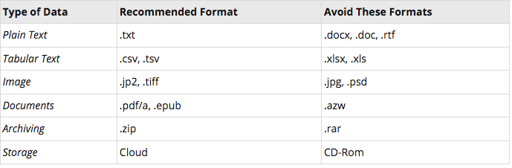
Data Storage
To prevent data from being lost to incompatibility, store it as formats and on hardware that are open standard, not proprietary.
When naming files in your data set, be consistent and descriptive.
Backup your data on local and remote external servers and have a contingency plan for restoring lost data.

Slide 58
Data management best practices
Don't dive straight into the deep end
Focus on data quality
Keep access as simple as possible
Take steps to reduce redundancies
Make data security a top priority
Have a strong recovery plan in place

Slide 59
Institutions provide a working environment
Astronomy (https://helpdesk.strw.leidenuniv.nl)
  Astronomical software
  Computing facilities
  Data storage
Physics (https://helpdesk.physics.leidenuniv.nl)
  Computing facilities
  Data storage

Slide 60
Security
Keep data save

Slide 61
Data Security
  Generic policies to which to adhere
  University Information security Policy
  GDPR
    Data processing register
    Center for Digital Scholarship

Slide 62
Keep your data safe and secure
External dangers:
  Watch for phishing
    poorly written
    unexpected messages
    attachment to open (often a .zip file)
    a link to click on
  If an email isn’t addressed to you personally, contains suspicious attachments or links or is sent from a bogus email address, it is probably a phishing scam.
Phishing infographic

Slide 63
Keep your data safe and secure
Backup your work
  Not your C: drive, but Group drive or data02
  USB stick/disk
  See later ‘Best Practices’
Use secure networks
  No public Wi-Fi
  Use ssh or vpn, tunnelier/webdrive

Slide 64
Keep your data safe and secure
Patch, patch, patch
  Always apply security patches immediately
Think twice
  Simple mistakes,
    Misplace laptop
    Send attachment to wrong person
  Travel
    Keep laptop on your person or locked away

Slide 65
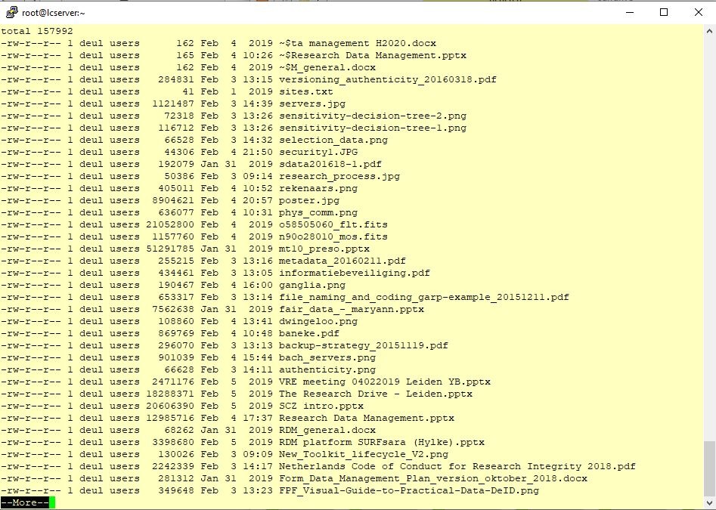
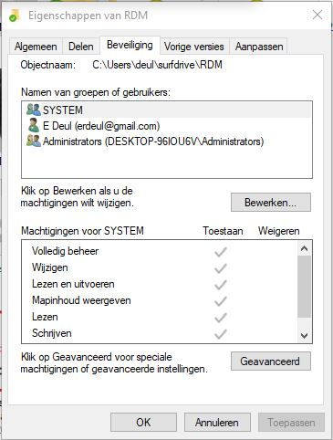
Shield data against malicious use
Access rights
  Groups and users in the domain and any trusted domains
  permissions are:
    Read
    Modify
    Change owner
    Delete
  Windows Explorer, right-click the file name, and click Properties. On the Security tab, you can change permissions on the file.
  Linux use the chmod utility (man chmod)

Slide 66
Best Practices
Practical Data management

Slide 67
Best Practices
Backup strategies
File naming convention
Versioning and Authenticity
Metadata
Selection of data
Sensitive data
Fair

Slide 68
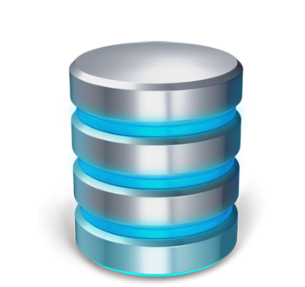
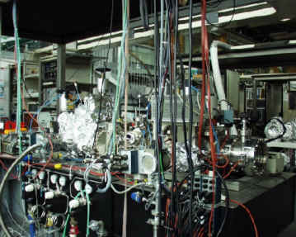
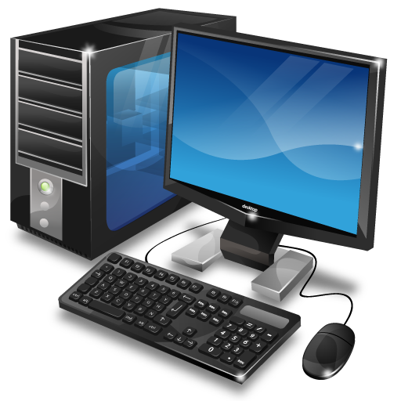
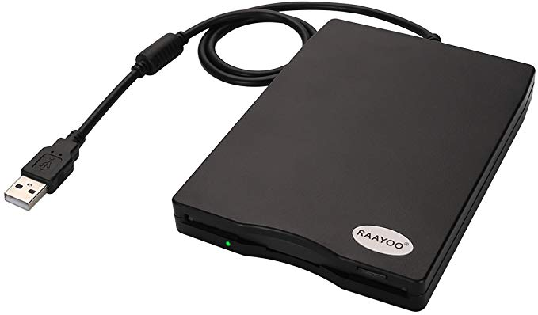
Backup Strategies (Physics)
Leiden
Delft
data02
data02backup

Slide 69
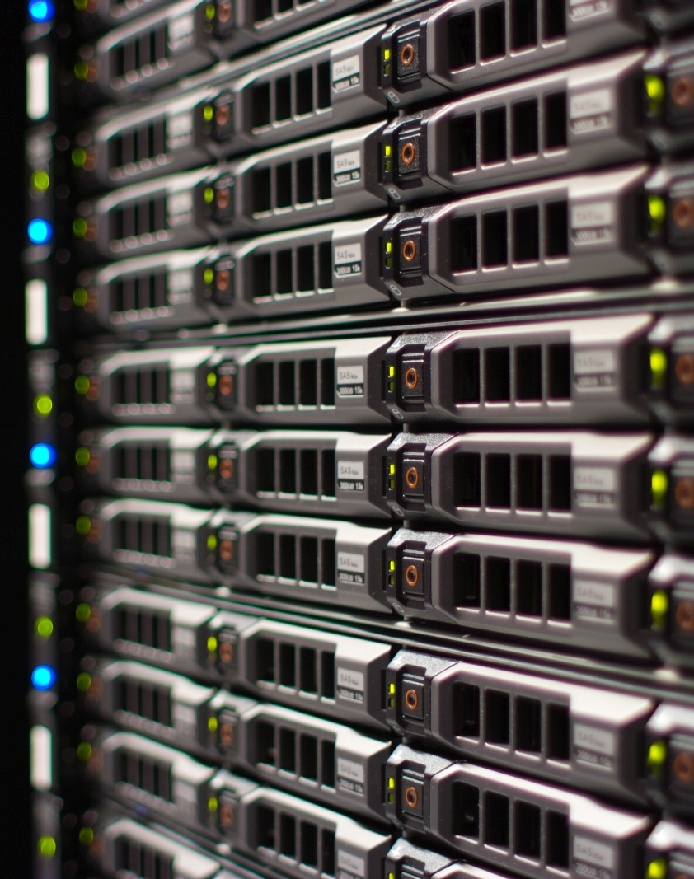
Backup Strategies (Sterrewacht)
Leiden
Telescope Institute
Server Storage
Bulk Storage

Slide 70
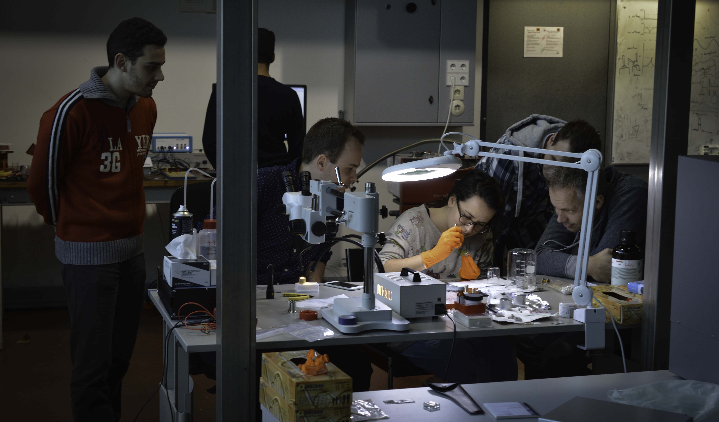
BSc Physics
Computer rooms
  HL104
  HL131
  HL305
  HL411

Slide 71
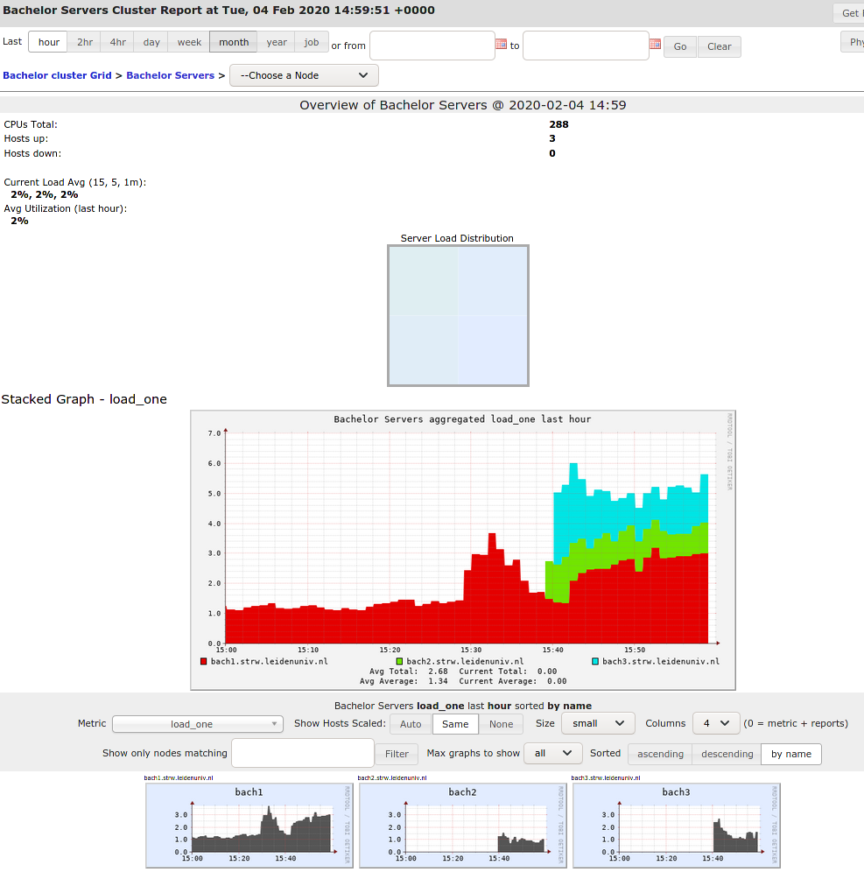
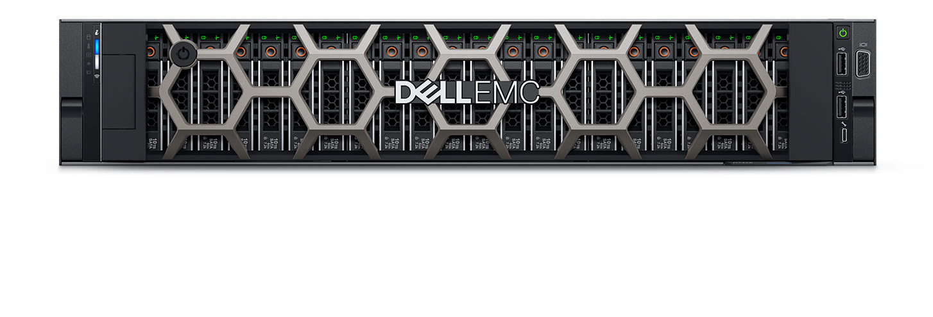
BSc Astronomy
Three high performance servers
  4 x AMD EPYC 7401 24-Core
  512GB RAM
  57TB storage

Slide 72
File naming Convention
Good file names:
are unique (not the same names in different folders)
are consistent (upper / lower case)
are permanent
are meaningful but brief
classify broad types of files
do not have spaces, dots and special characters
use hyphens ‘-’ or underscores ‘_’ to separate logical elements
reserve the 3 letter extension for application-specific codes
use the format YYYYMMDD (easy to find and sort chronologically)
20200205_ED_

Slide 73
File naming Convention
20120219_Nb25
20150413_testNb
2015_04_14_16_38_09_RT_NbTest_RT1_0T.txt
20150417_testNb
20150504DP_N_09
20150506_DP_N_09
20150508_DP_N_11
20150511_DP_N_12
20150512_DP_N_12
20150518_DP_N_13
20150521_DP_N_14
20150527_DP_F_01
20150602_DP_F_02
20150616_DP_N_15
20150617_DP_F_04
20150727_Sa225PyNb
20150729_TSV21
20150902_Sa175PyNb
20153026_DP_N_03
Graphs_DP_N_03
1TCryostat
7TCryostat
Allard
Amin
Amrita
Annette
Bachelor_Students
…
Jimi
Kaveh
__Manuals Cleanroom__profilometer
Master Students
meetpc86-sem-pc-cleanroom
Michel
Michel_DATA
Nikita
PhD Students
…
Z400_labbook_PRINTME.pdf
Z400_Logbook_ReadyToPrint.pdf
Folder structure:
pi-aarts
pi-aartsma
pi-allan
pi-bouwmeester
…
pi-vandermolen
pi-vanexter
pi-vanhecke
pi-vannoort
pi-vanruitenbeek
Stefano

Slide 74
Versioning and Authenticity
The version of a file can be identified via:
date in file (name)
version numbering in file name (v1, v2, v3 or 00.01, 01.00)
file history / version control table / notes in a file
recording versions, dates, authors and details of changes to the file
Version control can also be maintained through:
version control facilities within software (Ms Word)
versioning software, e.g. Subversion (SVN), GIT
controlling rights to file-editing
manual merging of entries or edits by multiple users
file sharing services with integrated version control (f.i. Sharepoint)

Slide 75
Versioning and Authenticity
It is important to be able to demonstrate the authenticity of data and to be able to prevent unauthorized access to data that may potentially lead to unauthorized changes.
Best practice to ensure authenticity is to:
save files with a new version number before editing
keep a single master file of data
  assign responsibility for master files to a single project team member
  regulate write access to master versions of data files
  record all changes to master files
  maintain old master files in case later ones contain errors
  archive copies of master files at regular intervals
  develop a formal procedure for the destruction of master files

Slide 76
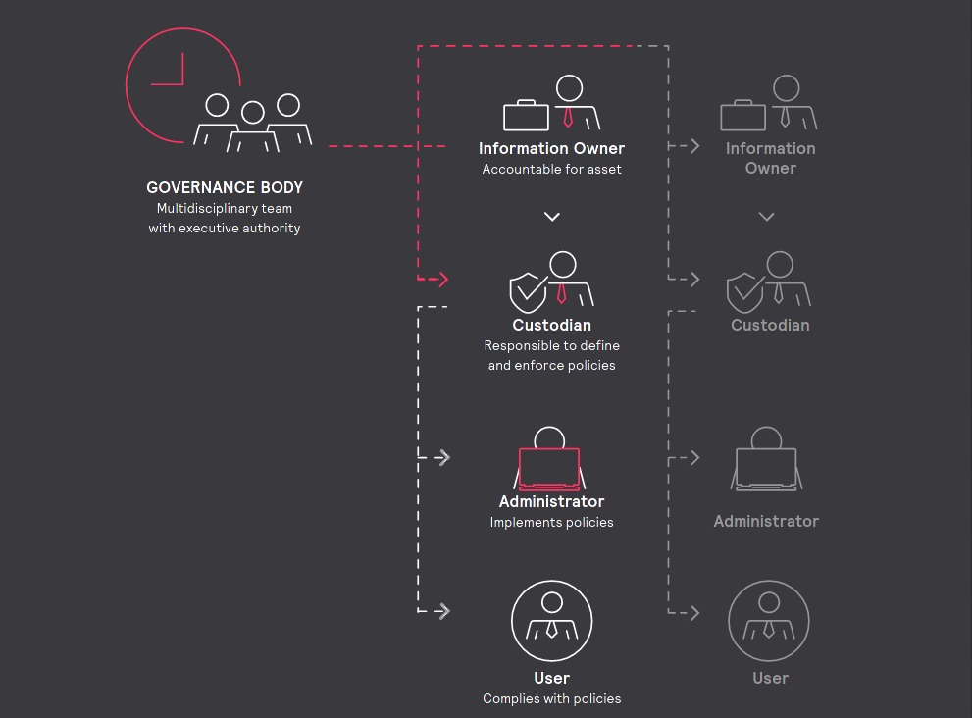
Gouvernance

Slide 77
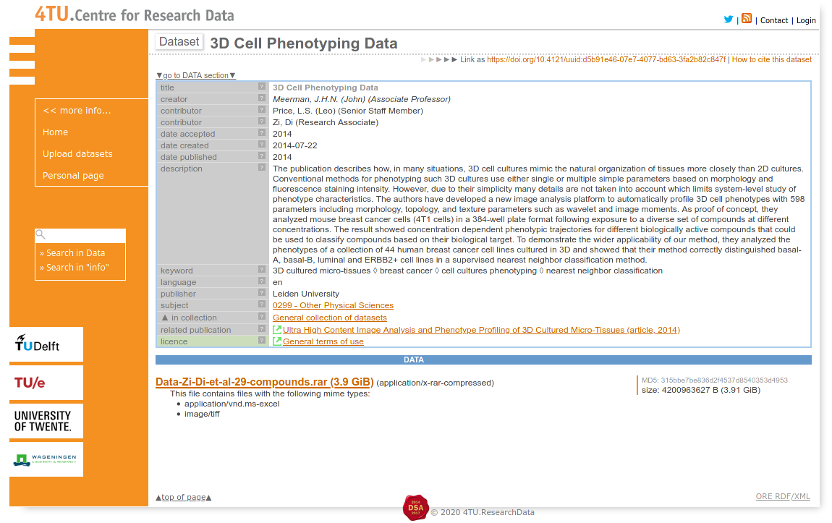
Metadata (data on the data itself)
Dublin Core
A well known standard, used by two national data archives (DANS and 4.TU.Datacentrum) is Dublin Core. The Dublin Core Metadata Element Set includes:
Title - the title of the data object
Creator - the person or entity responsible for creating the data object
Subject - subject terms or keywords that describe the data object
Description - a brief description, or abstract, of the data object
Publisher - the entity responsible for making the data object available
Contributor - a person or entity who contributed to the creation of the data object
Date - data of creation, publication, or revision of the data object
Type - the type of object. For data this would typically be "dataset"
Format - a description of the format or file type(s) of the data object
Identifier - a permanent identifier used to locate and identify the data object
Language - the language(s) used within the data object (if applicable)
Source - a relational element describing the lineage of the data object
Relation - a relational element describing the relationship of this data object to other objects, collections, or entities
Coverage - describes the spatial and temporal context of the data object
Rights - describes any rights, restrictions, or terms of use

Slide 78
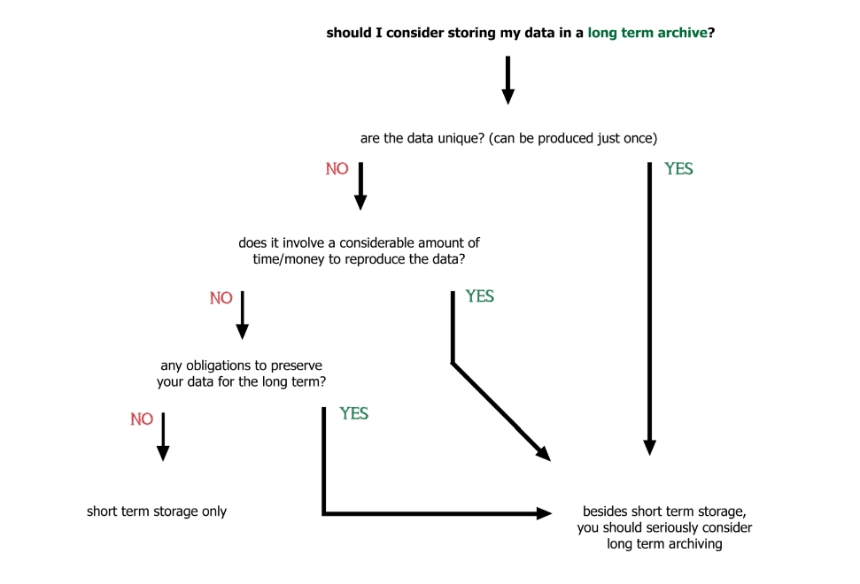
Selection of data
There can be different reasons for preserving research data:
They are valuable: potential value in terms of re-use, national/international standing and quality, originality, size, scale, costs of data production or innovative nature of the research
They are unique: the data contain non-repeatable observations
They are important for history, in particular the history of science
They are important for non-academic purposes, such as for cultural heritage, museums or other presentations

Slide 79
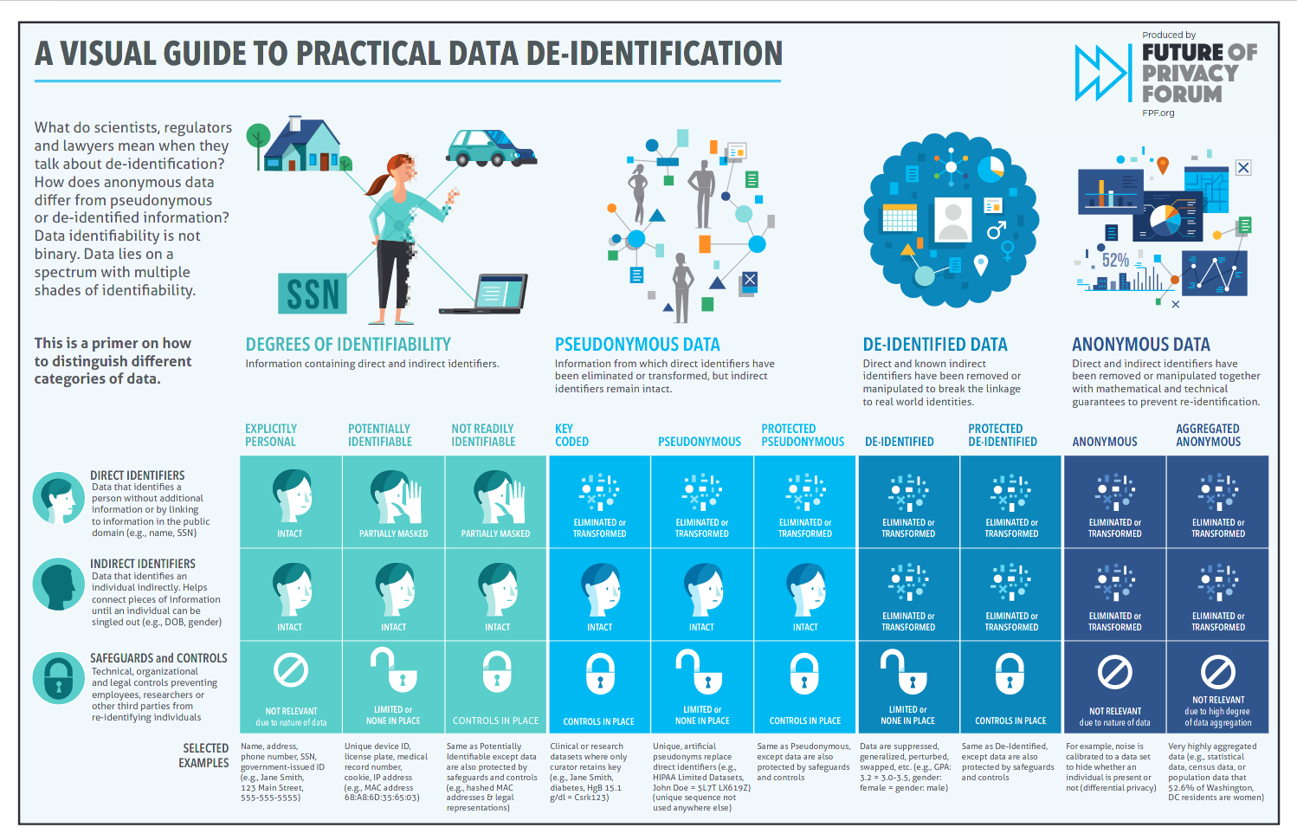

Slide 80
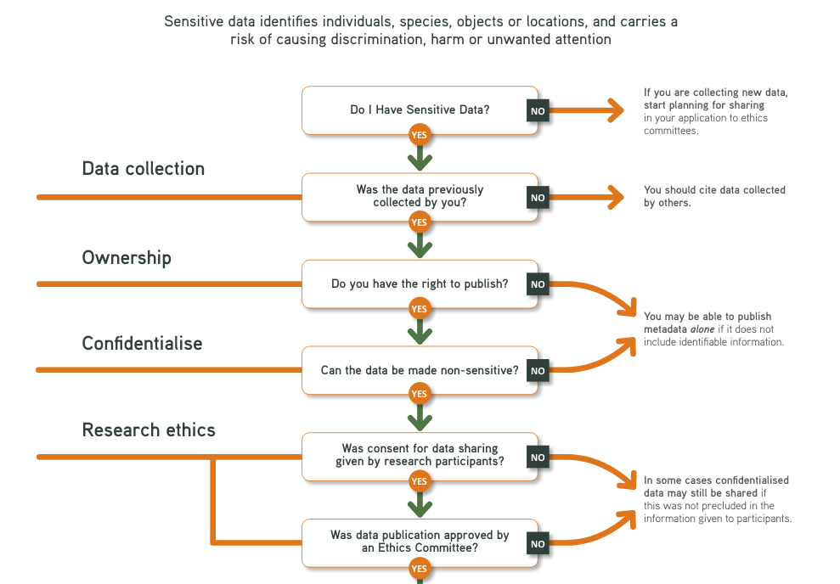

Slide 81
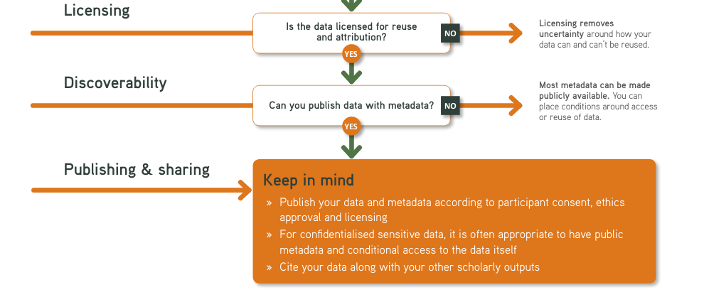

Slide 82
End
https://local.strw.leidenuniv.nl/~deul/RDM.pptx

